Slide 1
Marketplace New Design & User Story
2020.6.12

Slide 2
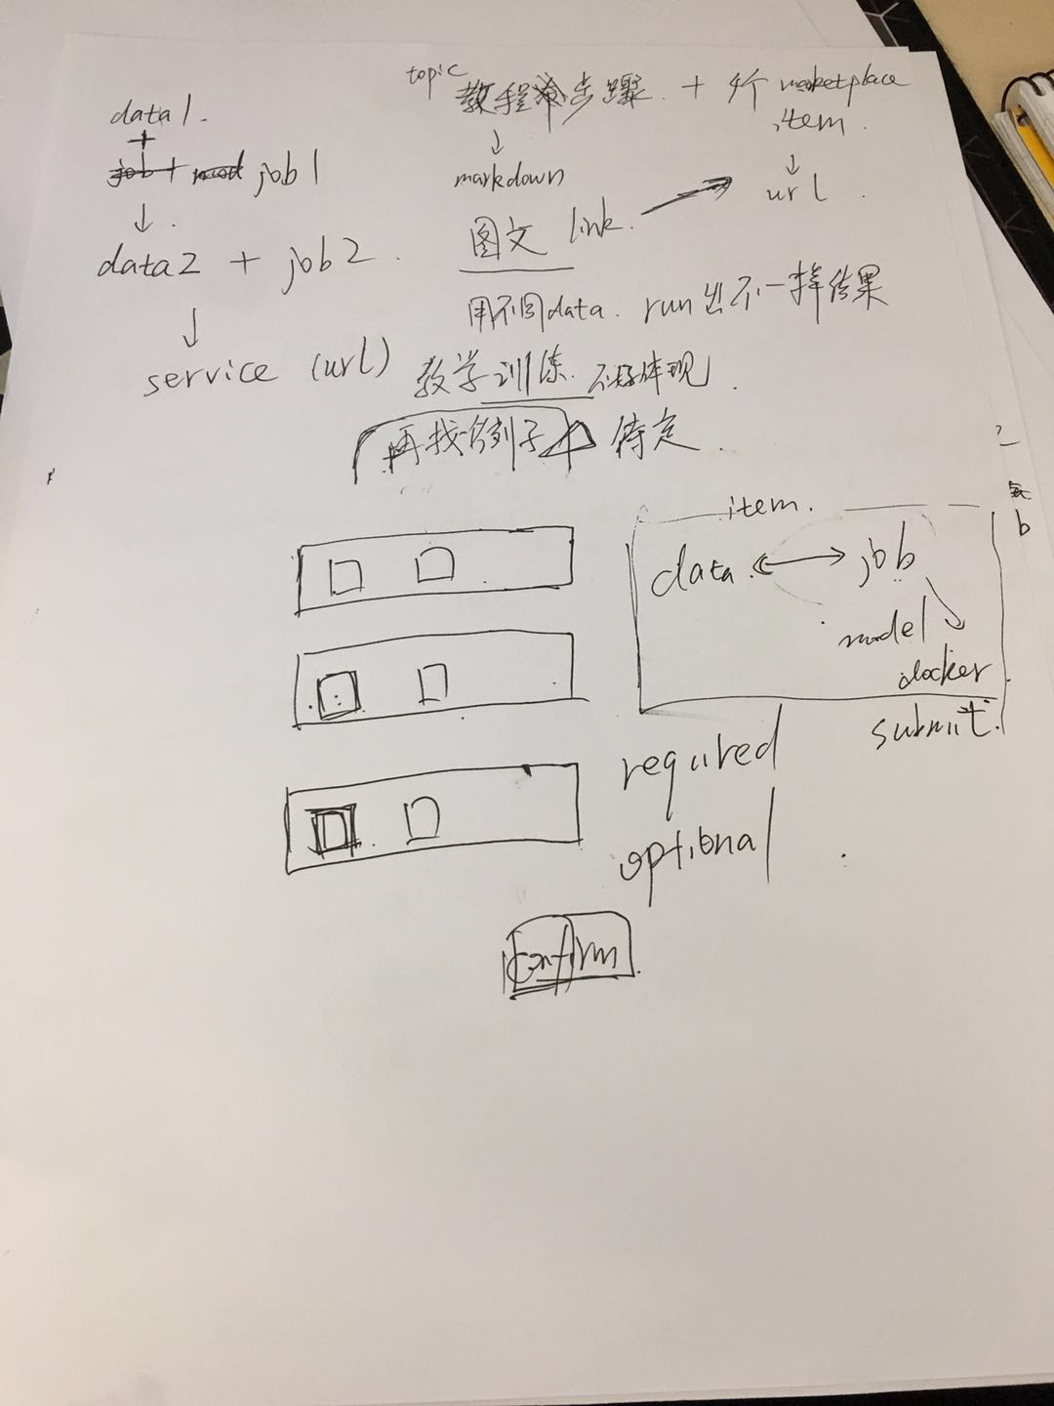
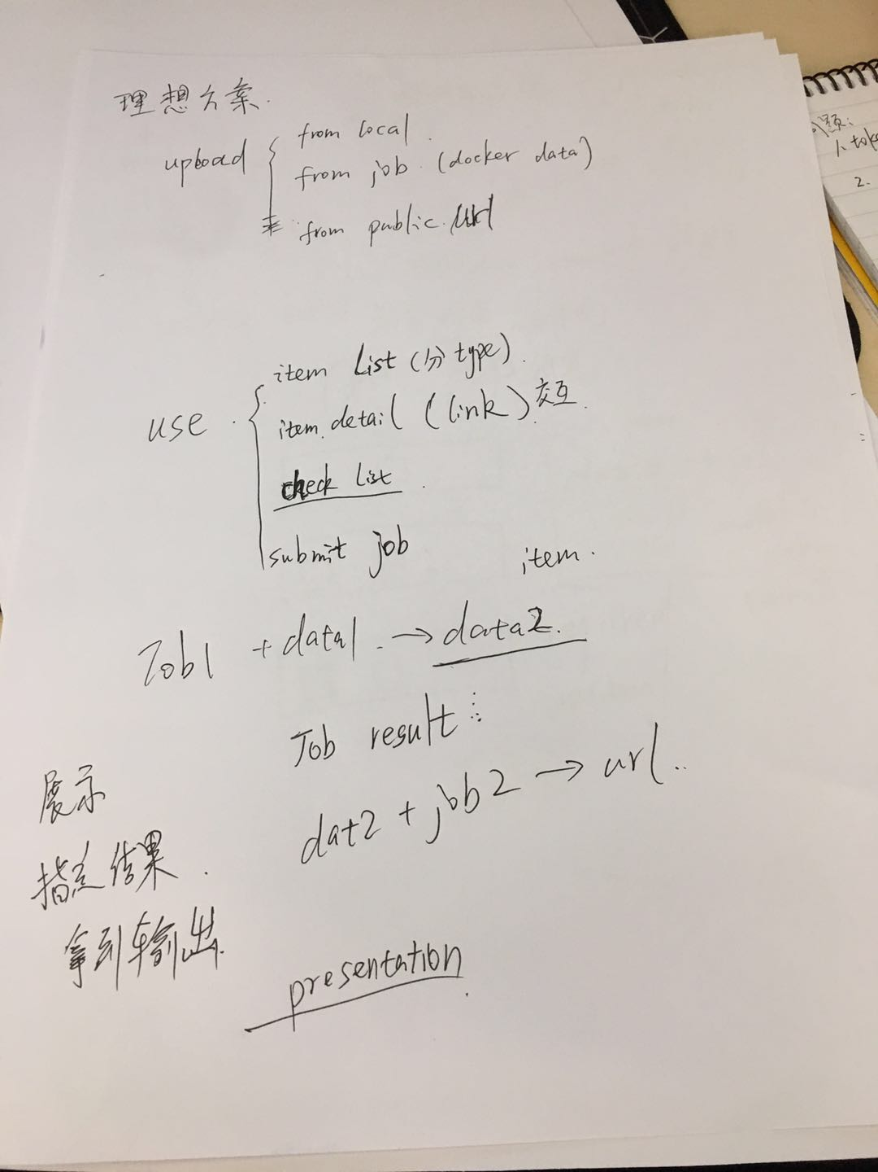
Notes:
Validate each module config with corresponding schema
Validate globalConfig with all schemas.
Validate each dependency module config with all corresponding schemas.
Allow default value
Only submodule appears in config will be processed

Slide 3
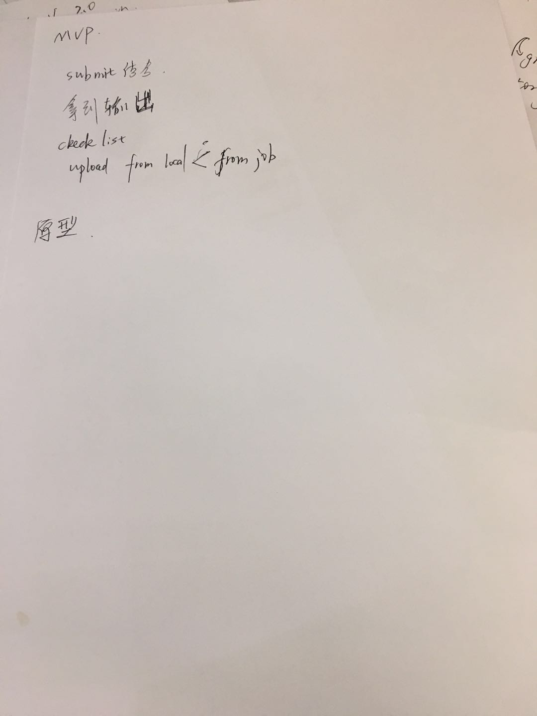
Notes:
Validate each module config with corresponding schema
Validate globalConfig with all schemas.
Validate each dependency module config with all corresponding schemas.
Allow default value
Only submodule appears in config will be processed

Slide 4
Marketplace
PAI
Template
Data
Tutorial
Model
Image
Submit job
Job detail
Tutorial Doc 01
Submit 01
Job 01
Data 01
Template 01
(training)
Check list (#01)
Data 02
Template 02
(inference)
Check list (#02)
Submit 02
Job 02
Service(URL)

